Slide 1
Diabetes Mellitus – Management in Fasting
Dr Shenaz Seedat
Endocrinologist
Greenslopes Private Hospital

Slide 2
Outline
The physiology of fasting
Risks associated with fasting
Management – general considerations
Management of fasting in type 1 diabetes mellitus
Management of fasting in type 2 diabetes mellitus
Fasting in Ramadaan
Summary and recommendations
Questions

Slide 3
Pathophysiology of fasting
Insulin secretion, which promotes the storage of glucose in the liver and muscle as glycogen, is stimulated by feeding in non-diabetic individuals.
During fasting, circulating glucose levels fall, leading to decreased secretion of insulin.
Concurrently, levels of glucagon and catecholamines rise, stimulating the breakdown of glycogen and gluconeogenesis.
As fasting becomes prolonged for more than several hours, glycogen stores become depleted and there is increased fatty acid release from adipocytes.

Slide 4
Pathophysiology of fasting
Oxidation of fatty acids generates ketones that can be used as fuel by skeletal and cardiac muscle, liver kidney and adipose tissue, sparing glucose for continued utilisation by brain and erythrocytes.
In patients with diabetes mellitus, this glucose homeostasis is altered by the underlying condition and often by pharmacological agents designed to enhance or supplement insulin secretion.
In patients with type 1 diabetes, glucagon secretion may fail to increase appropriately in response to hypoglycaemia.

Slide 5
Pathophysiology of fasting
In patients with severe insulin deficiency, a prolonged fast in the absence of adequate insulin can lead to excessive glycogen breakdown and increased gluconeogenesis and ketogenesis, leading to hyperglycaemia and ketoacidosis.

Slide 6
Risks associated with fasting in diabetics
1. Hypoglycaemia
2. Hyperglycaemia
3. Diabetic ketoacidosis
4. Dehydration and thrombosis

Slide 7
Hypoglycaemia
Accounts for 2-4% of mortality in patients with type 1 DM.
There are no reliable estimates concerning the contribution of hypoglycaemia to mortality in type 2 DM.
The EPIDIAR (Epidemiology of Diabetes and Ramdaan) study showed that fasting during Ramadaan increased the risk of severe hypoglycaemia 4.7 fold in patients with type 1 DM (from 3 to 14 events /100 people/month) and 7.5 fold in patients with type 2 DM (0.4 to 3 events /100 people/month).
  Events requiring assistance from a third party without the need for hospitalisation were not included.

Slide 8
Hyperglycaemia
Glycaemic control in patients with diabetes who fast has been reported to deteriorate, improve or show no change.
The EPIDIAR study showed a fivefold increase in the incidence of severe hyperglycaemia (requiring hospitalisation) during Ramadaan in patients with type 2 DM (from 1 to 5 events /100 people/month) and an approximate threefold increase in the incidence of severe hyperglycaemia with or without ketoacidosis in patients with type 1 DM (5 to 17 events /100 people/month).
Hyperglycaemia may have been due to excessive reduction in doses of medications to prevent hypoglycaemia.

Slide 9
Dehydration and thrombosis
Limitation of food and fluid intake during fasting, especially if prolonged, is a cause of dehydration.
In addition, hyperglycaemia produces an osmotic diuresis, further contributing to volume and electrolyte depletion.
Contraction of the intravascular space can further exacerbate the hypercoagulable state.
This may enhance the risk of thrombosis and stroke.
  A report from Saudi Arabia suggested an increased risk of retinal vein occlusion in patients who fasted during Ramadaan. Hospitalisations due to coronary events or stroke were not increased.

Slide 10
High risk patients
Severe recurrent hypoglycaemia
Hypoglycaemic unawareness
Poor glycaemic control
Ketoacidosis within the 3 months prior to fasting
Episode of hyperosmolar non-ketosis in preceding 3 months
Acute illness
Chronic dialysis
Poor adherence with respect to blood glucose monitoring

Slide 11
Low risk patients
Well controlled type 2 diabetes mellitus
  Lowest risk in patients treated with
    lifestyle therapy,
    metformin,
    acarbose,
    thiazolidinediones and/or
    incretin-based therapies
in otherwise healthy individuals.

Slide 12
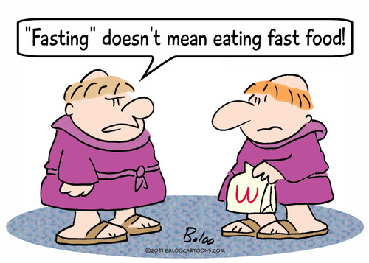
General considerations
  Understanding the underlying pathophysiology of type 1 and type 2 diabetes mellitus.
  Understanding the mechanism of action of agents used to treat diabetes.
  Raising the general awareness of Ramadaan and management of this.

Slide 13
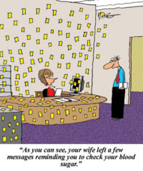
General Considerations
Individualisation
  Assessment of risk for individual patients.
  Management plan will differ for each specific patient and will be dependent on;
    Pharmacotherapy being used for management of diabetes mellitus
    Glycaemic control
    Hypoglycaemic awareness
    Comorbidities
Frequent glucose monitoring
  Especially crucial in patients with
  type 1 DM and in patients with type 2
  DM who require insulin.

Slide 14
Management of patients with type 1 diabetes
Higher risk
  Exacerbated in poorly controlled patients, those with limited access to medical care, hypoglycaemic unawareness, unstable glycaemic control or recurrent hospitalisations.
  Very high risk in patients unwilling or unable to check their blood glucose levels several times daily.
Patients will usually be treated with multiple daily insulin injections or insulin pump therapy.
The current understanding is that the basal-bolus regimen is the preferred protocol for management if patients are treated with multiple subcutaneous injections.
Patients using pump therapy should be educated in adjustment of their basal rates, which usually need be adjusted downwards to abort hypoglycaemia.
Bolus doses often need to be adjusted with change in carbohydrate intake.

Slide 15
Management of patients with type 2 diabetes
Diet-controlled patients
  Distributing calories over two to three smaller meals during the nonfasting interval may help prevent excessive postprandial hyperglycaemia.
Patients treated with oral agents
  In general, agents that act by increasing insulin sensitivity are associated with a significantly lower risk of hypoglycaemia than compounds that act by increasing insulin secretion.
Metformin
  Patients treated with metformin alone may safely fast because the possibility of severe hypoglycaemia is minimal.
  Timing of doses may be modified to suit when meals are being consumed.
  Caution regarding renal impairment in dehydration

Slide 16
Management of patients with type 2 diabetes
Glitazones
  The thiazolidinedione agents are not indepently associated with hypoglycaemia, though they can amplify the hypoglycaemic effects of sulphonylureas and insulin.
  Are associated with weight gain and anecdotally can be associated with increased appetite.
  Require 2-4 weeks to exert substantial antihyperglycaemic effects and cannot be quickly substituted for agents for agents associated with hypoglycaemia during periods of fasting.

Slide 17
Management of patients with type 2 diabetes
Suphonylureas
  Severe or fatal hypoglycaemia is a relatively rare complication of sulphonylurea use.
  It has been suggested that glibenclamide may be associated with a higher risk of hypoglycaemia than other second generation sulphonyureas such as gliclazide, glimepiride and glipizide.
  May be used in fasting with caution.
  Consider dose decrease and change to timing of administration.

Slide 18
Management of patients with type 2 diabetes
Incretin-based therapies
  DPP-4 inhibitors (saxagliptin, sitagliptin, vildagliptin, and linagliptin)
    Not independently associated with hypoglycaemia (although can increase the hypoglycaemic effects of sulphonylureas and insulin)
    Very low risk of hypoglycaemia when used with metformin, therefore safe option.
  GLP-1 receptor agonists
    Exenatide has a short half life of 2 hrs and is not associated with a substantial effect on fasting glucose.
    Liraglutide is dosed once daily, independent of meals, and is more effective in controlling fasting glycaemia

Slide 19
Management of patients with type 2 diabetes
Alpha glucosidase inhibitors eg acarbose
  Slow absorption of carbohydrates when taken with the first bite of a meal.
  Not associated with an independent risk of hypoglycaemia and therefore may be useful when fasting.
  Only modestly effective and exert little or no effect on fasting glucose, and are therefore usually used in combination with other agents to control fasting glucose.

Slide 20
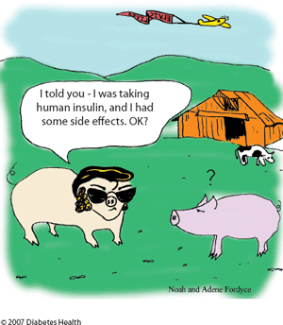
Management of patients with type 2 diabetes
Insulin
  Aim to maintain necessary levels of basal insulin to prevent fasting hyperglycaemia.
  An effective approach is to use an
  intermediate- or long-acting insulin plus
  a short-acting insulin administered before
  meals.
  Hypoglycaemia still a risk.
  Suggestion that rapid acting insulin
  analogues instead of regular human
  insulin before meals is associated with
  less hypoglycaemia and smaller
  postprandial glucose excursions.

Slide 21
Diabetes and Ramadaan
The EPIDIAR study (2001) demonstrated among 12,243 people with diabetes from 13 countries, that ~43% of patients with type 1 diabetes and ~79% of patients with type 2 diabetes in 13 muslim countries fasted during Ramadaan.
  Estimated that more than 50 million people with diabetes fast during Ramadaan.
Ramadaan is a lunar based month and it’s duration varies between 29 to 30 days.
Fasting is from dawn to dusk and includes abstaining from eating, drinking and smoking during those hours.

Slide 22
Diabetes and Ramadaan
Most people consume two meals per day during this month, one before dawn and one after sunset.
Fasting is not meant to create excessive hardship and there is exemption for individuals with medical conditions where fasting is too difficult or is dangerous to one’s health.

Slide 23
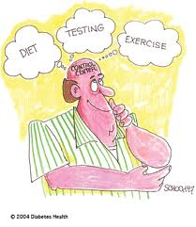
Pre-fasting assessment
All patients with diabetes mellitus wishing to fast during Ramadaan should undergo a prior medical assessment.
Many Muslims with diabetes are passionate about fasting during Ramadaan.
  This provides an opportunity to empower patients and motivate them to better manage diabetes during Ramadaan and throughout the year.

Slide 24
Pre fasting assessment
Should include;
  importance of glucose monitoring in fasting and non-fasting hours,
  when to stop fasting,
  meal planning to avoid hypoglycaemia and dehydration
  appropriate meal choices to avoid postprandial hyperglycaemia
  timing and intensity of physical activity during fasting
  Advice regarding the use of diabetic pharmacotherapy

Slide 25
Pre fasting assessment
Nutrition
  During Ramadaan there is a major change in the dietary pattern compared with other times of the year.
  The common practice of ingesting large amounts of foods rich in carbohydrates and fats, especially at the sunset meal, should be avoided.
  Ingestion of foods containing complex carbohydrates may be advisable at the pre dawn meal.
  Fluid intake should be increased during nonfasting hours.
Exercise
  Excessive physical activity may lead to a higher risk of hypoglycaemia and should be avoided, particularly during the few hours before sunset.

Slide 26
Breaking the fast
All patients should understand that they must always and immediately end their fast if hypoglycaemia occurs (blood glucose <3.3mmol/l)¹.
  Or if blood glucose <3.9mmol/l in the first few hours after starting fasting, especially if administering insulin or sulphonyurea drugs¹
  More conservative threshold in patients more prone to hypoglycaemia.
The fast should be broken if blood glucose exceeds 16.7mmol/l¹.
Patients should avoid fasting on “sick days”.
1. Recommendations for Management of Diabetes During Ramadaan; Al-Arouj et al. Diabetes Care, Vol 33, 8, Aug 2010.

Slide 27
Recommendations for Management of Diabetes During Ramadaan; Al-Arouj et al. Diabetes Care, Vol 33, 8, Aug 2010.

Slide 28
Summary
Consultation with patients prior to fasting/low-calorie diets
  Importance of regular glucose monitoring
  Indications to break fast
  Adjustment of diabetic pharmacotherapy
    Caution with sulphonyureas and dose adjustment of insulin
    Consider changing to DPP-4 inhibitors or GLP-1 receptor agonists.
  Education of patients using insulin pump therapy
  Review of factors potentially posing a high risk of hyper- or hypoglycaemia

Slide 29
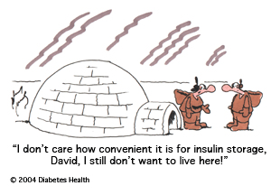
Thank-you
Questions?

